Slide 1
Cross-Border Themed Tourism Routes in the southern African region: practice and potential
Prof Karen Harris
Hannes Engelbrecht
Sian Pretorius
Department of Historical and Heritage Studies University of Pretoria (2018-2019)
Research Day 15 March 2019

Slide 2
PURPOSE OF THE STUDY
understand tourism products in cross-border themed tourism routes in the SADC region
explore the possibility of integrating routes to enhance a cross-border niche tourism experience
explore other international mechanisms, systems or processes
identify methods to improve the broader functionalities of the sector
consider ways in which the sector could be enhanced to contribute to the broader economy and unemployment
In essence, the intention of this study is to develop and test a model for the development and implementation of guided cross-border themed tourism routes according to existing and potential tourism niche markets.

Slide 3

Research Reports of 2012-2018
CROSS-BORDER TOURISM
Department of Heritage and historical studies
University of Pretoria
2013 – 2018
“Understanding the Concept of Cross-Border Guiding in Southern Africa”, 2012
“Harmonization of Tourist Guide Training Regulations and Standards in South Africa”, 2013
“Harmonisation of Tourist Guide Training in southern Africa – phase III” 2014
“Harmonised Tourist Guide Training in southern Africa – phase IV” 2015
“Cross-Border Tourism pilot project: The Namibian-South African Corridor” 2017-2018

Slide 4
TOURISM is a rapidly growing globalised industry
Product diversification and global competitiveness
Recent trends include:
Cross Border tourism
Route tourism
Niche tourism

Slide 5
TOURISM CHALLENGES & TRENDS
CROSS-BORDER TOURISM
movement of tourists across the borders of a country under the guidance of a qualified tourist guide
ROUTE TOURISM
linking together of a series of tourism attractions under a unified theme to promote entrepreneurial opportunities among the local communities
NICHE TOURISM
specific tourism product which is custom-made to meet the needs and demands of a particular audience/market segment group of tourists
Need for renewal

Slide 6



Tourism Benefits in Africa
A powerful vehicle for economic growth and job creation
Tourism is growing faster in the world’s emerging and developing regions than in the rest of the world
Potential of tourism has not been fully recognized as a vital source of economic and development power that can strengthen and expand the continent’s economies.

Slide 7
CROSS-BORDER TOURISM ROUTES
border regions peripheral / marginal
integration of value chains
augment foreign investment
diffuse innovations
intensify tourist flows
multiply socio-economic effects
(Stepanova, 2017)

Slide 8
TOURISM-SCAPES
“A landscape portrayed and utilised in a tourism context, like when a list of arbitrary tourist attractions is combined into a route based on a thematic approach”

Slide 9
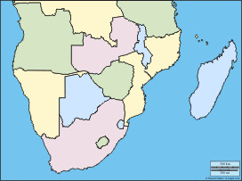
SOUTHERN SADC
Namibia
Botswana
Zimbabwe
Mozambique
Swaziland
Lesotho

Slide 10
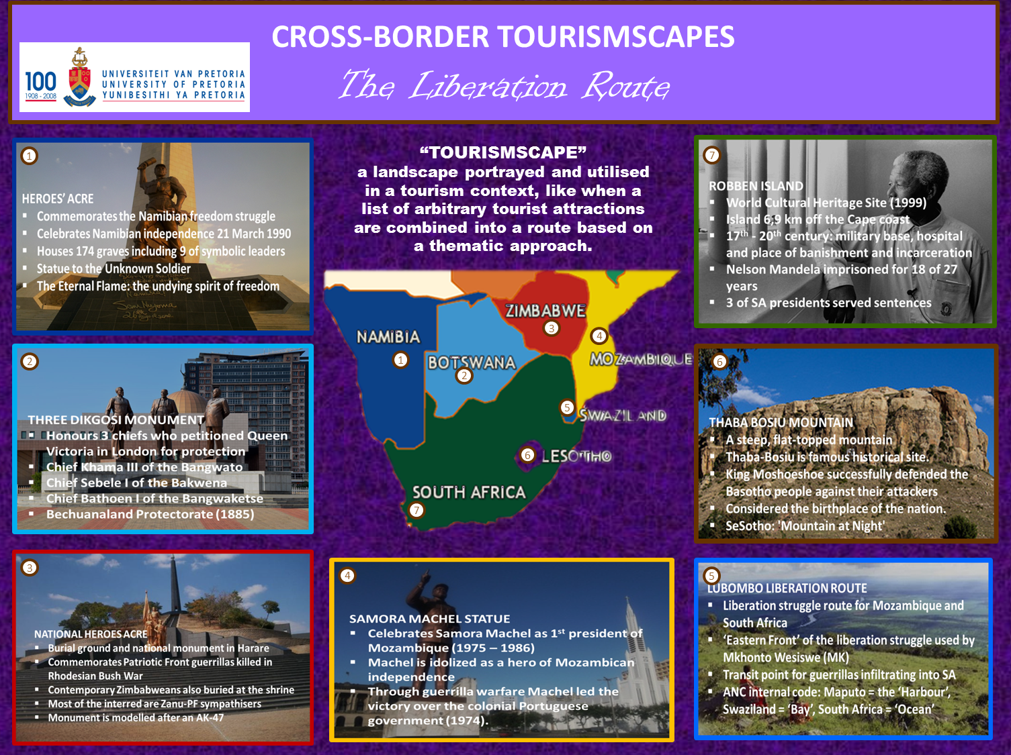
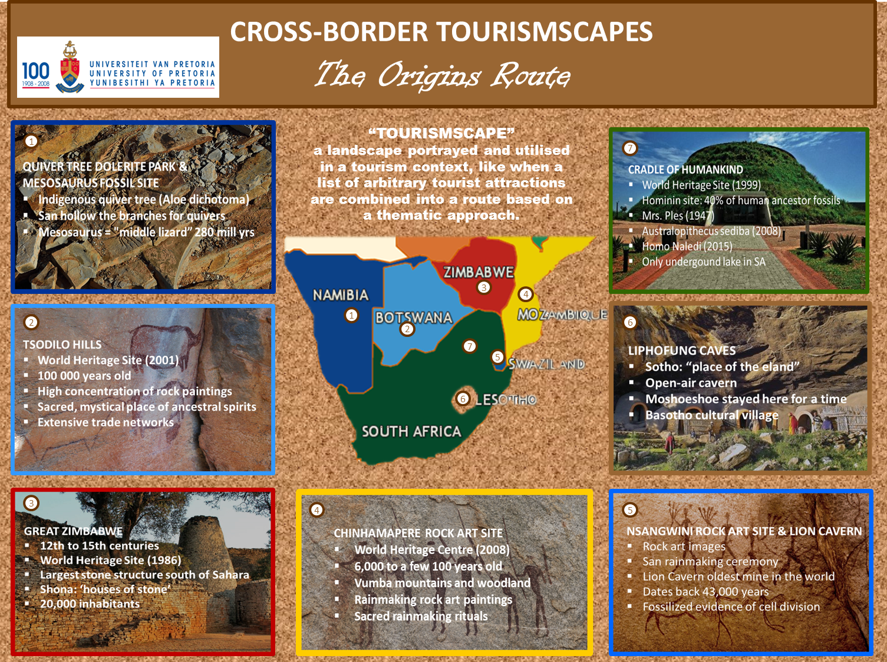
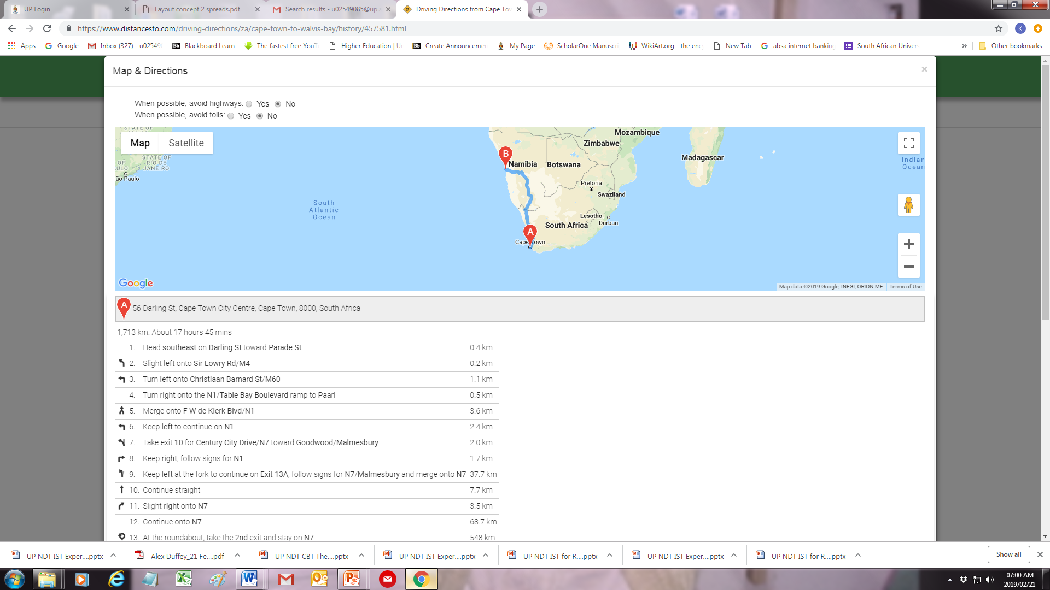
TOURISMSCAPES
NAMBIA-SOUTH AFRICA CORRIDOR

Slide 11
Themed cross-border tourist routes
“Tourism-scapes”
Origins Route – fossils, first inhabitants and first kingdoms
Colonial Remnants Route – colonial histories and heritages
Liberation Route – movements opposed to colonial oppression
Literature and Film Route – literary and film tourism sites
7 Natural Wonders of Southern Africa – nature attractions
Culinary Route – tasting and learning to cook the local cuisines
Culture Rumble Route – cultural villages and attractions
Supernatural Southern Africa – mysterious local legends on monsters, ancestors, spirits, ghosts and other supernatural occurrences.

Slide 12
RATIONALE OF THE STUDY
DESTINATION AND PRODUCT DEVELOPMENT
PRODUCT DIVERSIFICATION
REGIONAL CO-OPERATION
ACCUMULATIVE BENEFITS

Slide 13

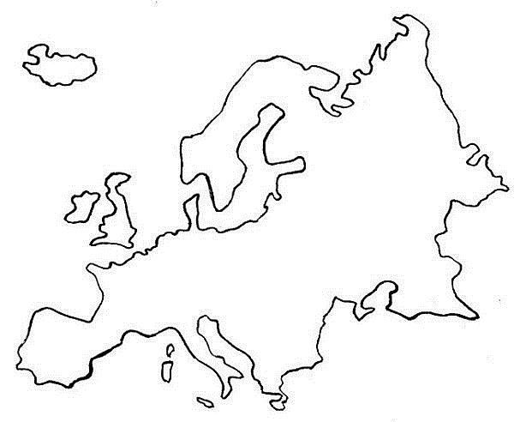
INBOUND TRAVEL MARKET SHARE
2016
4,7%
50%
Collaborate – not compete

Slide 14
Possible solution
“development of new tourism products [through] the connection of already established forms of tourism with alternative/niche tourism products [,…] including cultural tourism”
Acolla Cameron, Niche Focused Tourism Development in Small Island Developing States: The case of Trinidad”, Academic Conferences Association, 2017, p. 732

Slide 15
Literature Review
- Cross border:
D.J. Timothy; Association of European Cross-border Communities (AEBR); H. Wachowiak; K. Vodeb; E. K. Prokolla; S.V. Stepanova; G. Skaremo; A. Murphy.
Theme Routes:
C.M. Rogerson; J. Briedenhann & E. Wickens; D. Meyer; M. Lourens; J.D. Snowball & S. Courtney
Niche tourism:
N.J. Morgan; & A. Pritchard; M. Novelli; J.M. Ali-Knight; A. Cameron; G. Visser & G. Hoogendoorn
Tourist Experiences:
J. Pine & J. Gilmore; E. Cohen; N. Wang; P. Pearce; G. Moscardo; A. Zatori.

Slide 16
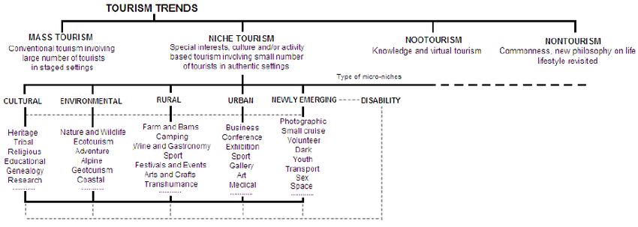
Niche Tourism Framework (Novelli, 2005)

Slide 17
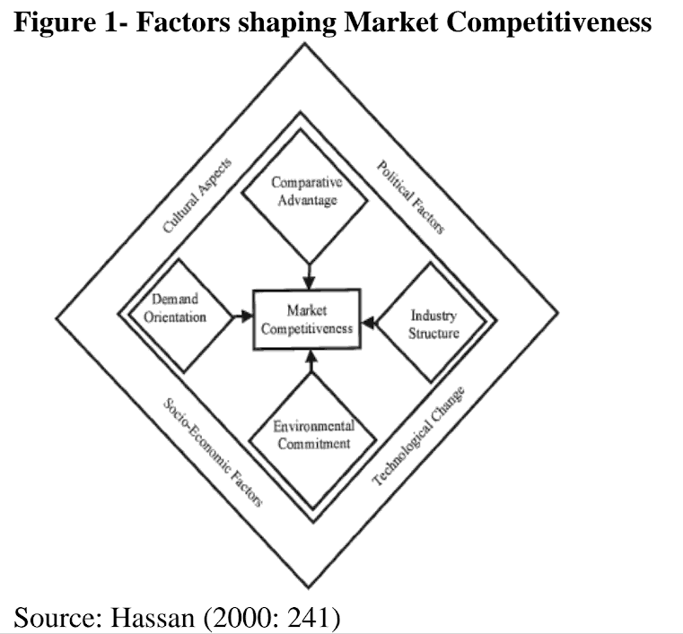
Niche Tourism market competitiveness (Cameron)

Slide 18
Key stakeholders in CBTRE development
CBTRE
in
SADC
The Host Communities
Governmental Bodies
Tourism Industry
Tourists
Voluntary Sector
Experts
Pressure Groups
Media
Competitors
Adapted from J. Swarbrooke

Slide 19
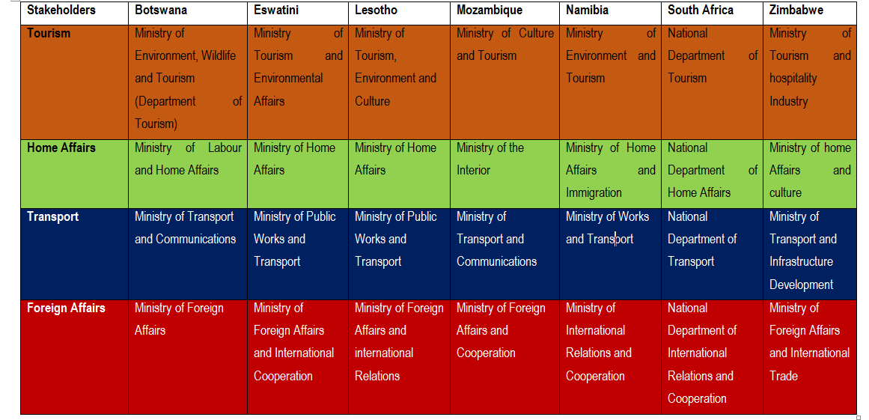
Government Stakeholder departments – 7 SADC countries

Slide 20
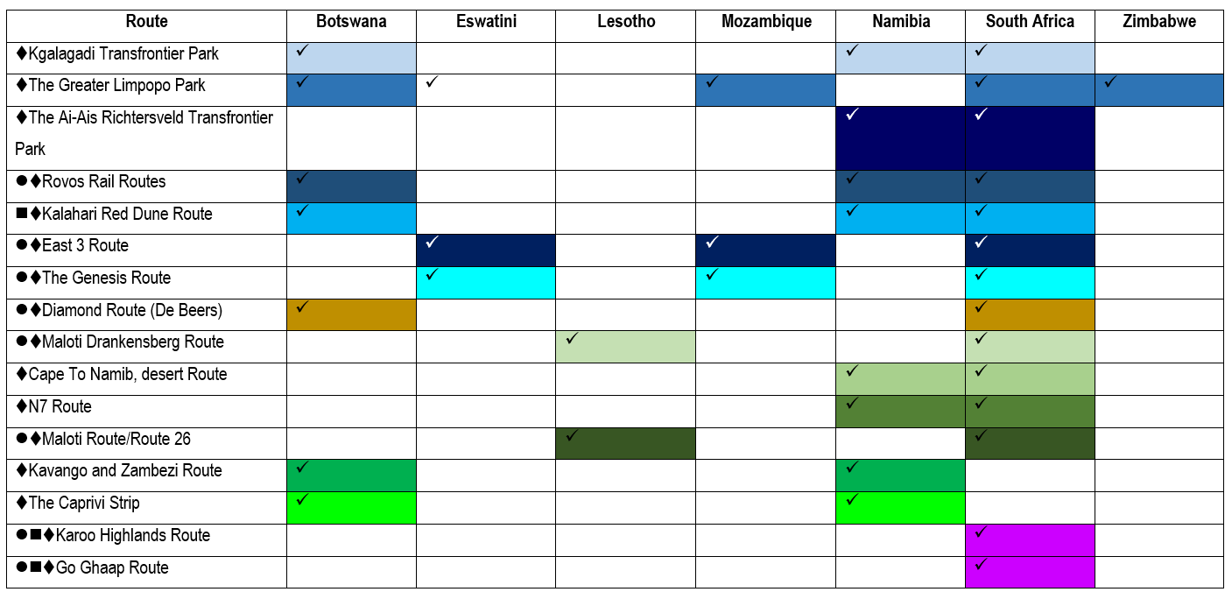
Existing routes – 7 SADC countries: Culture & Adventure & Nature

Slide 21
Challenges
facing CBT
Borders as barriers
Hinder travel
Intimidating
Challenges in SADC:
Varied levels of development (SA – 34 & Swaziland 167)
Infrastructure (Technical and Social)
Transport (air, road, rail connectivity)
Coordination and Collaboration
Legislation and regulations (Acts 1992-2014)
Customs and Immigration (Visas (“evisa”?))
Language
Currencies
Competitiveness
Standards and quality assurance
Safety and Security

Slide 22
Short term
mitigations
Enabling structures
Involve stakeholders
Mitigations and solutions in SADC:
Collaboration and partnerships (smaller)
Diplomacy and supra-national agreements (1996-2013)
Regionally accepted currency
Investment
Visa consolidation and exemption (Univisa)
Harmonization of standards(SADC Tourism Protocol 1998
Experience diversification (opportunities…)

Slide 23

TOOL
KIT
Two aspects:
general guiding principles: considerations throughout the development process
a three phase development plan: with more specific actions and considerations in each phase

Slide 24
Guiding principles of CBTRE development

Slide 25
PRACTICAL:
Realistic time constraints
Accommodation, meals, transport, budget
Improve experience
Additional information – safety, health, forex
Downtime
Market with creative language
Optional extras
STRUCTURAL:
Legal requirements
Administrative issues
Partnerships to co-create
Standards at attractions
Research conducted
Competiveness - uniqueness

Slide 26
EXPERIENTIAL:
Levels of immersion
Engage senses – smell, touch, taste, sight, hear
Subject specific lingo
Flexibility
Drama, myth, story telling
Tourists as co-creators
Education opportunity
Spontaneity
On-going experience – at and in between
Theme suites the selected destinations, attractions activities and experiences

Slide 27
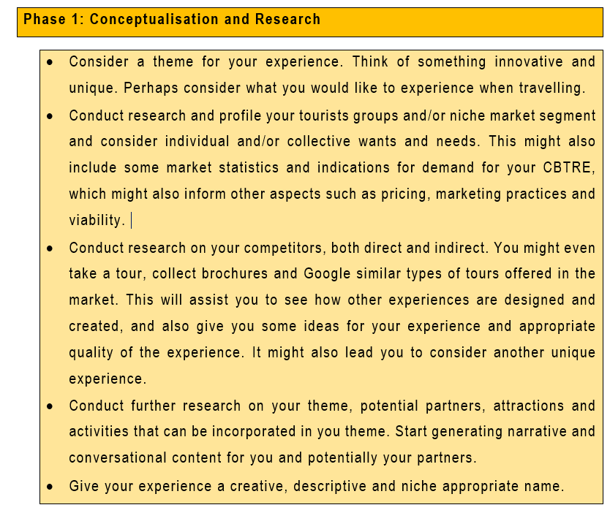
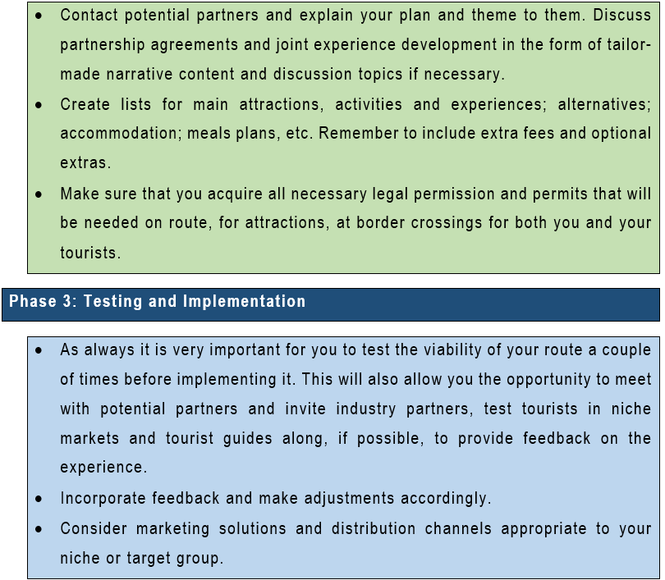
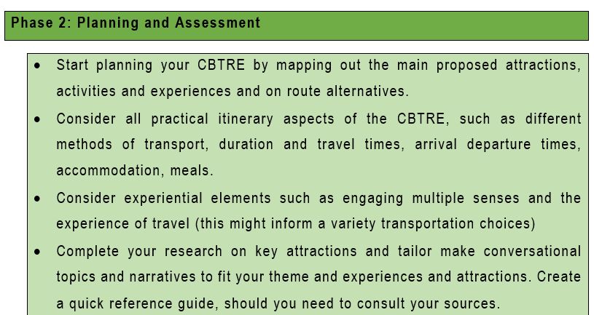
A three phase development plan

Slide 28
PHASE 1: CONCEPTUALIZATION AND RESEARCH
Identify a theme (innovative, unique, niche)
Conduct research (desktop, field and indigenous)
Conduct network research (partners, activities)
Brand - creative name or angle
PHASE 2: PLANNING AND ASSESSMENT
Mapping (route and alternatives)
Practicalities (transport, accommodation, meals, timing)
Complete research and follow ups on key attractions
Contact potential partners
Tailor-made narrative and content
Check permissions (legal)
PHASE 3: TESTING AND IMPLEMENTATION
Viability (check route, meet partners, feedback)
Incorporate feedback
Marketing and distribution channels

Slide 29
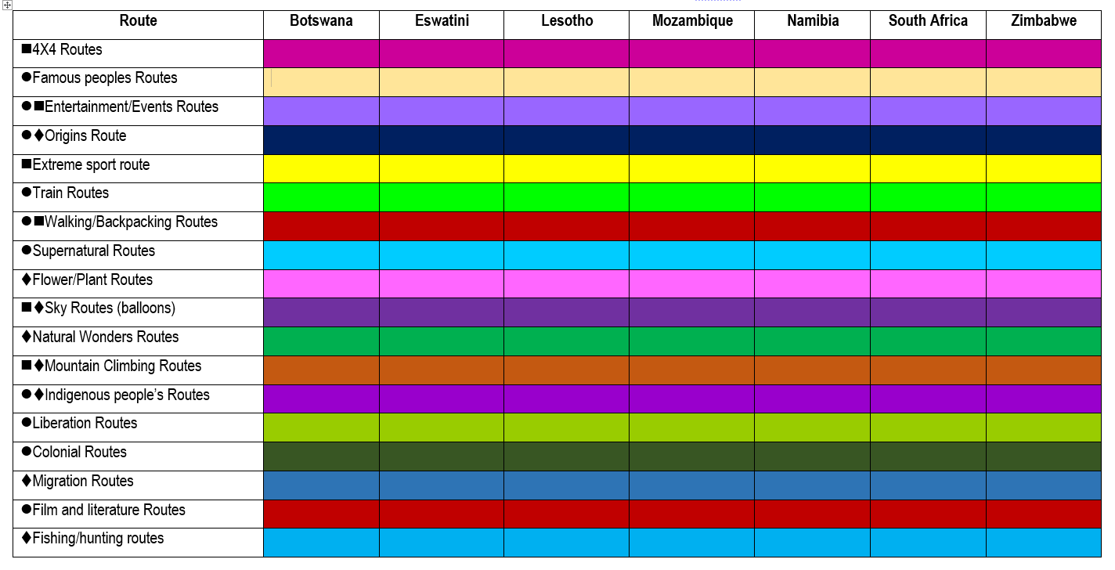
Potential Combination Routes – 7 SADC countries: Culture & Adventure & Nature
Tourismscape – Theme: Film Tourism

Slide 30

1980s
US$ 51.2 million
Award Winning
- Sequels

Slide 31


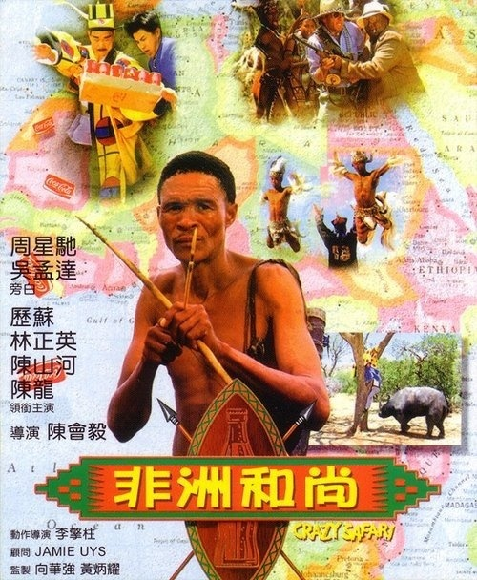


Slide 32
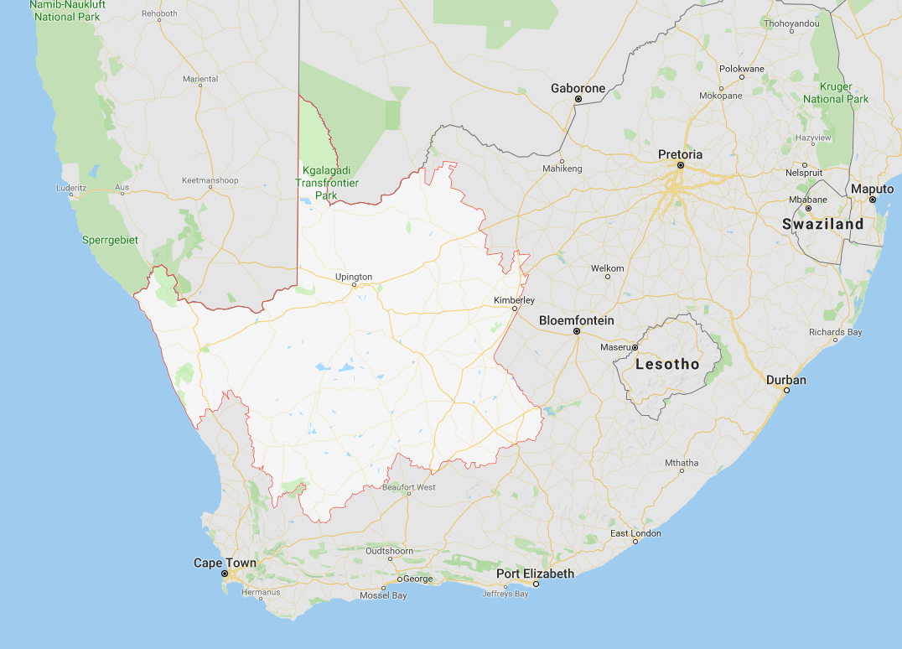
Northern Cape, Namibia, Mpumalanga, Botswana

Slide 33
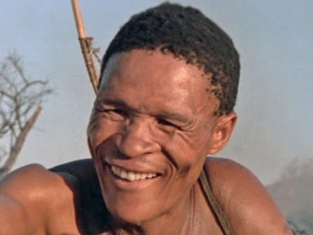
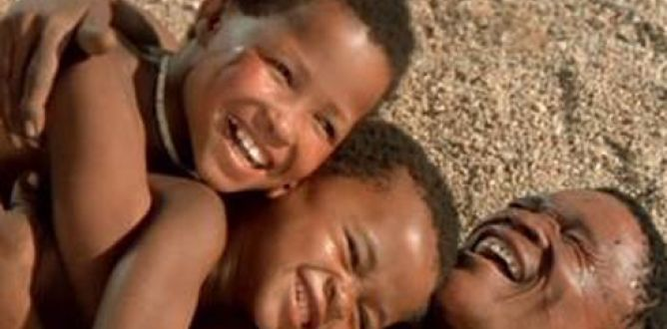
BUSHMAN PEOPLE

Slide 34
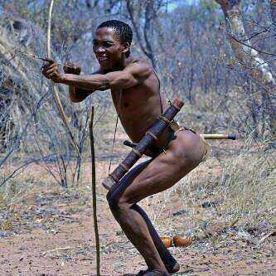
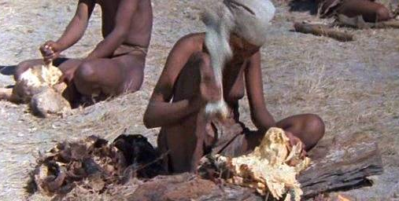
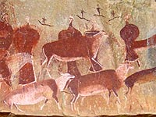
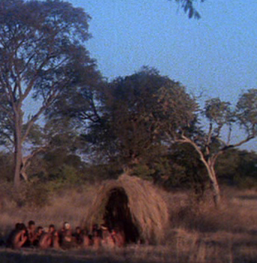
BUSHMAN CULTURE

Slide 35
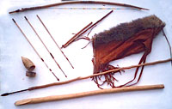
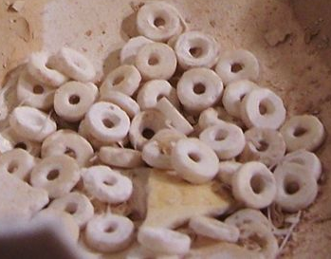
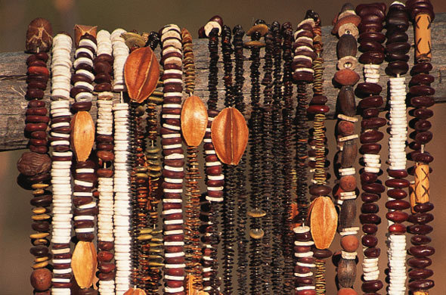
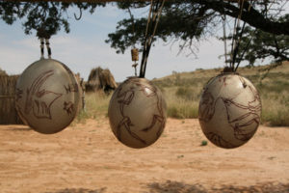
BUSHMAN CREATIVE INDUSTRIES

Slide 36

- 2018
- US$ 900 million
- Award Winning

Slide 37
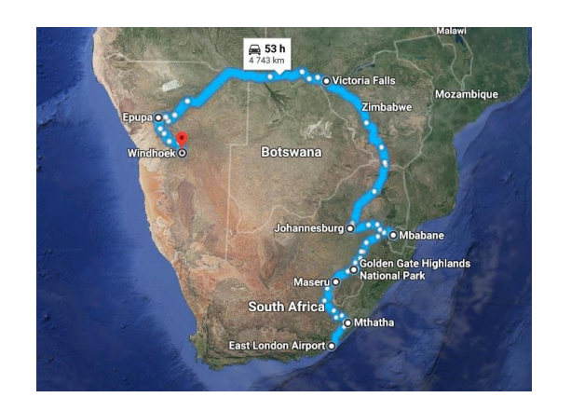
The Southern African Wakanda Experience Route

Slide 38



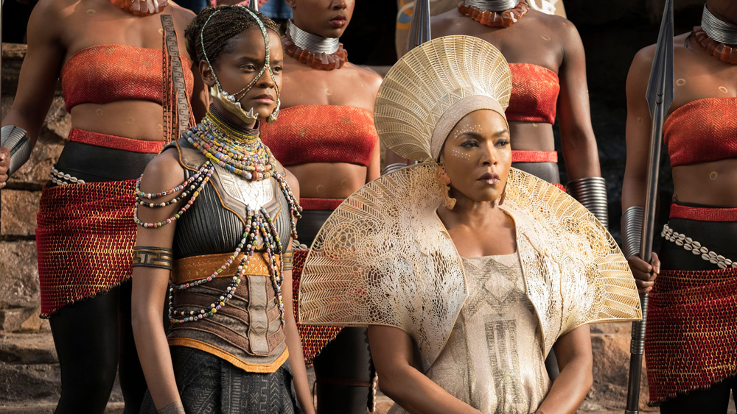
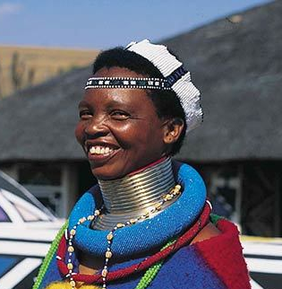
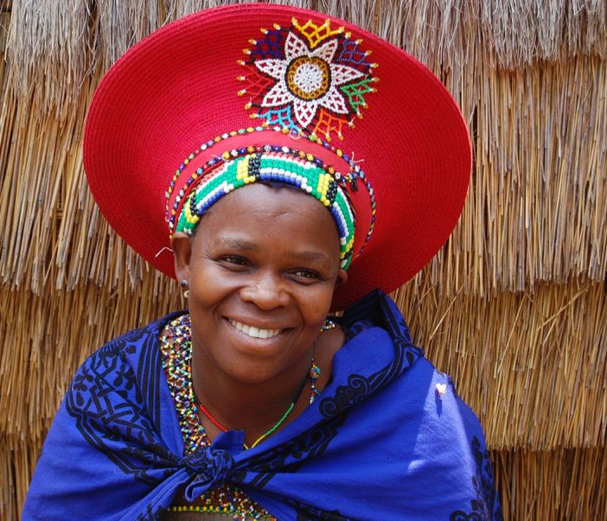
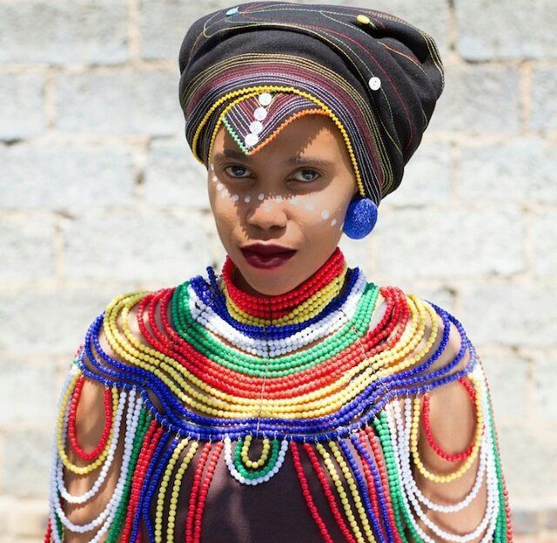
Ndebele
Zulu
Xhosa

Slide 39
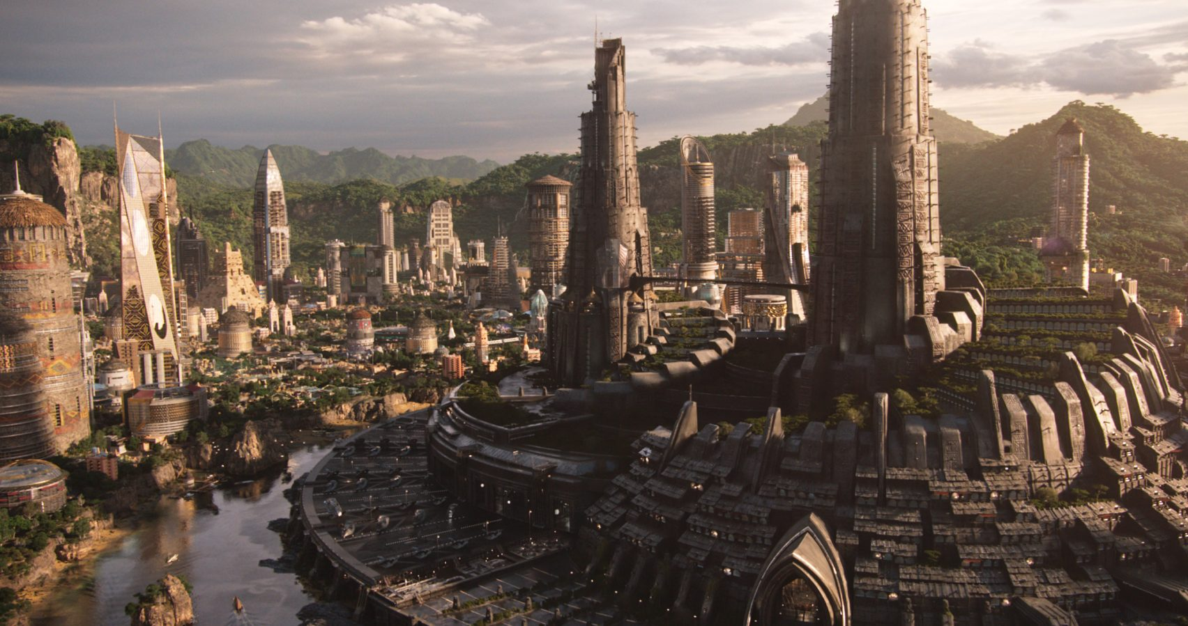
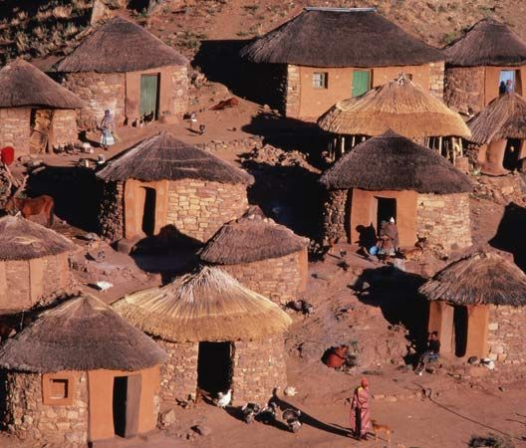
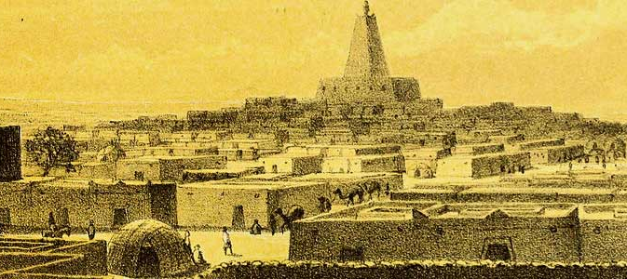
Sotho-Tswana rondavels (huts)
Timbuktu

Slide 40
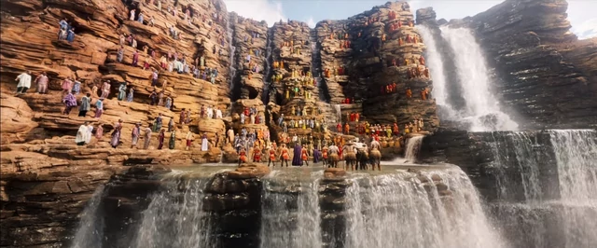
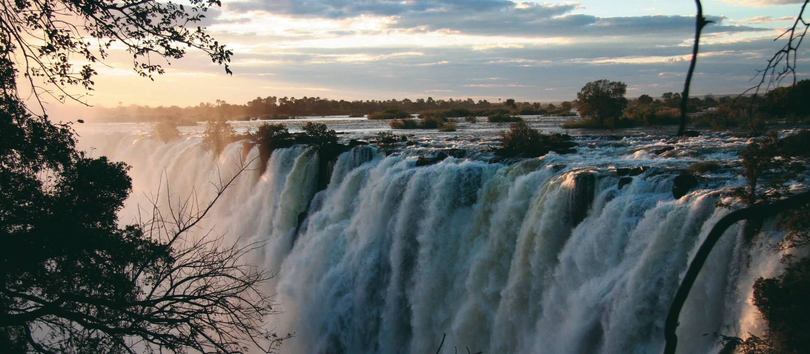
Victoria Falls

Slide 41
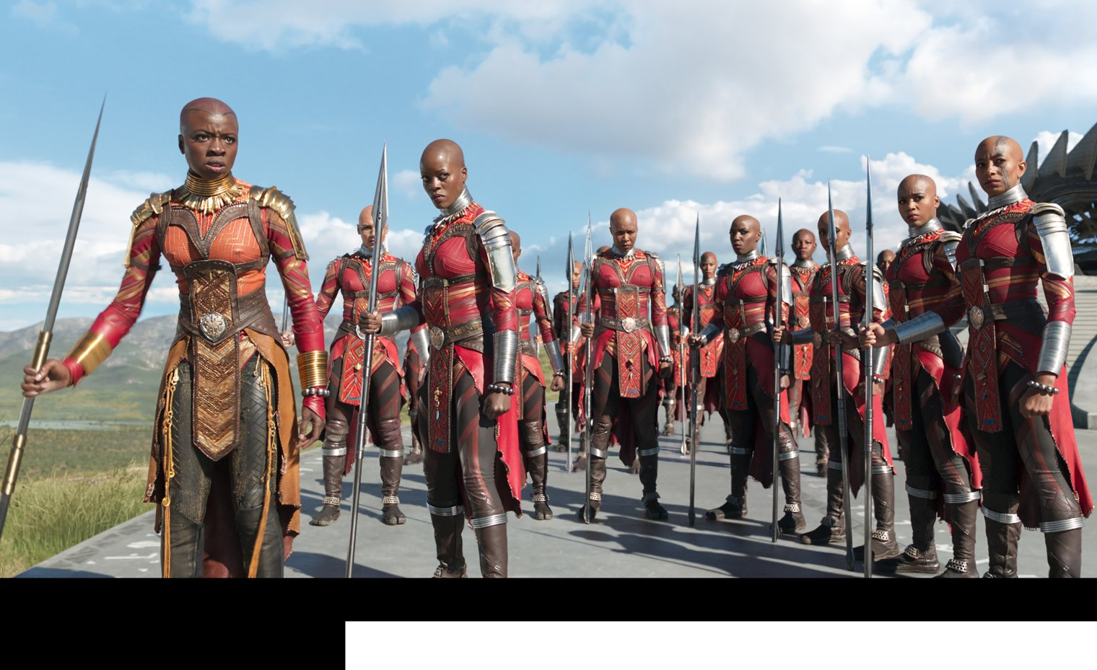
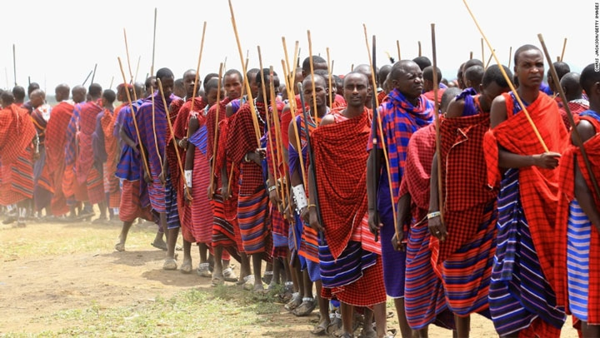
Maasai

Slide 42
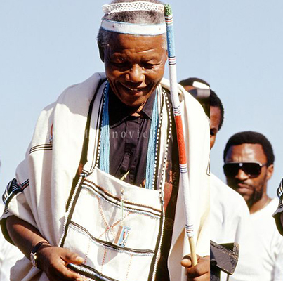
isiXhosa
The language of Wakanda

Slide 43
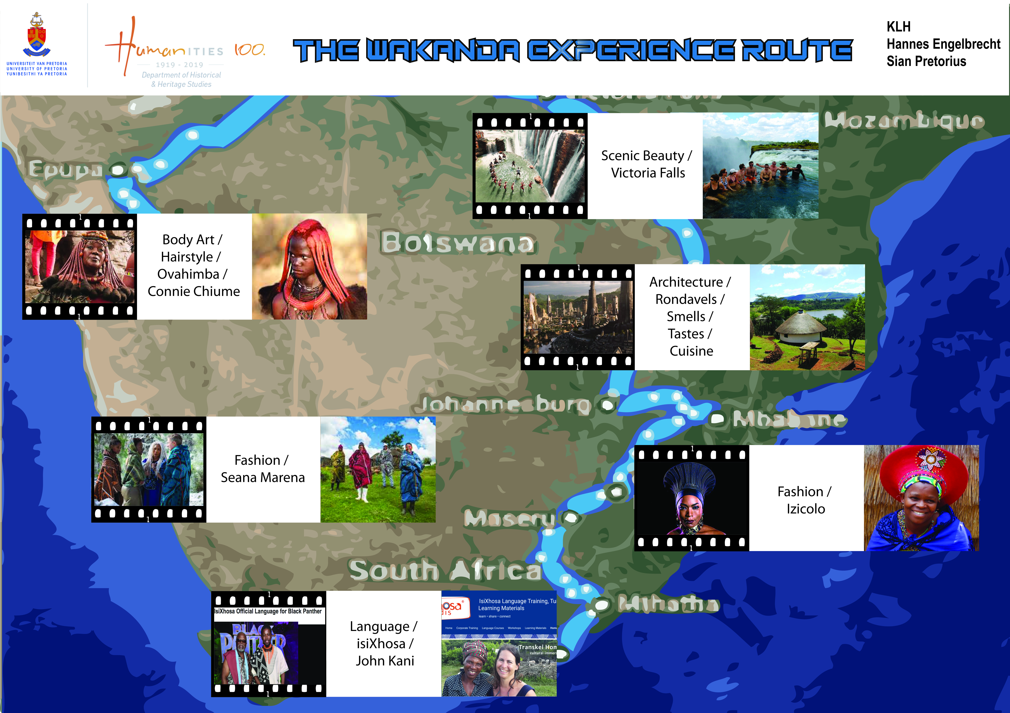

Slide 44

Thank you!
Professor Karen Harris
Mr Hannes Engelbrecht
Ms Sian Pretorius
Mr CR Botha

